Slide 1
Predicting Pneumonia with Neural Networks
Dr. Kyle Boerstler, Ph.D.

Slide 2
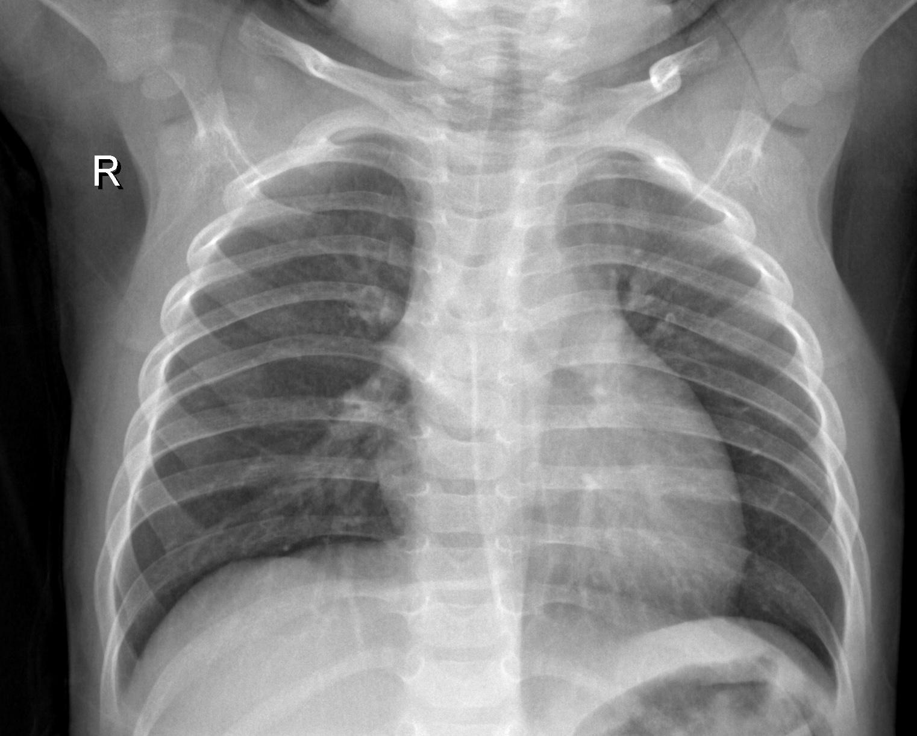
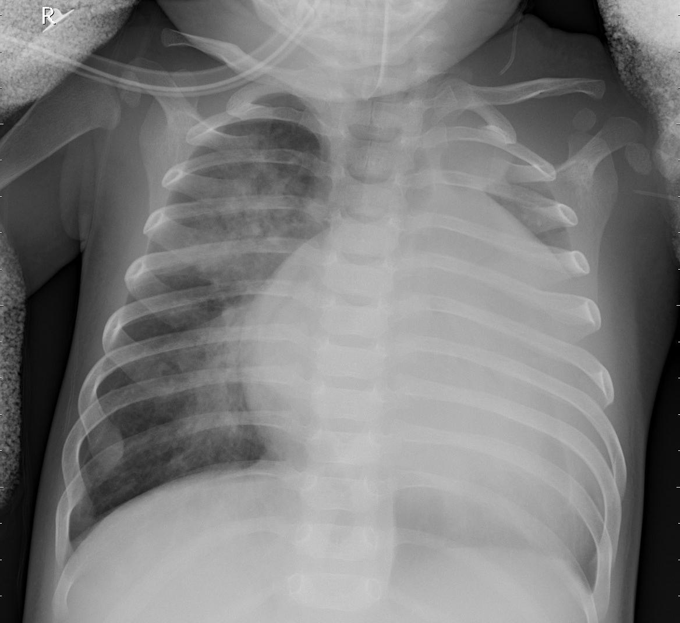
Normal
Pneumonia

Slide 3
Preparing the Images
ImageDataGenerator to read in and manipulate the files
Dataset:
5216 images in train set (⅓ healthy, ⅔ pneumonia)
624 images in test set (balanced)
16 images in holdout set (balanced)
Moved 70 images from Train set to holdout set to increase size of set for final comparison.
Augmented train images by adding 15 degree rotations and 0.1 shear to randomly selected images for each epoch.
Images in grayscale, so made a set of grayscale and a set of RGB images (using skimage) to check for differences in model performance.

Slide 4
Hit the Books!
Stick to using Adam and SGD with nesterov and momentum at first, and if time try some other optimizers.
Use Relu for speed, but Selu with lecun normalization might be something to try.
Learning rate, decay, and schedulers! (I didn’t have time to mess with schedulers, but learned how to do it)
Batch Normalization to prevent overfitting, and use it everywhere according to Skylar’s book™.
Tune, tune tune! Sometimes a model just needs a little tuning to work a lot better.

Slide 5
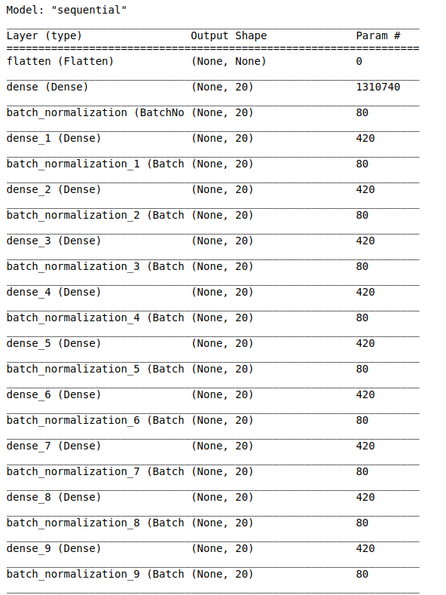
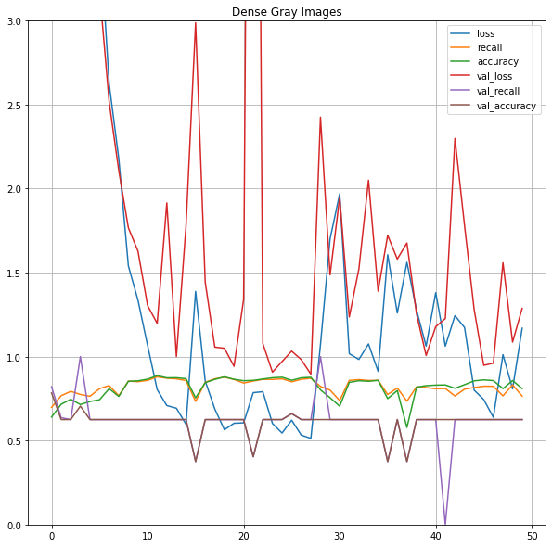
Building the Models: Deep, Dense Layers(w/Selu)
...for fifty layers!

Slide 6
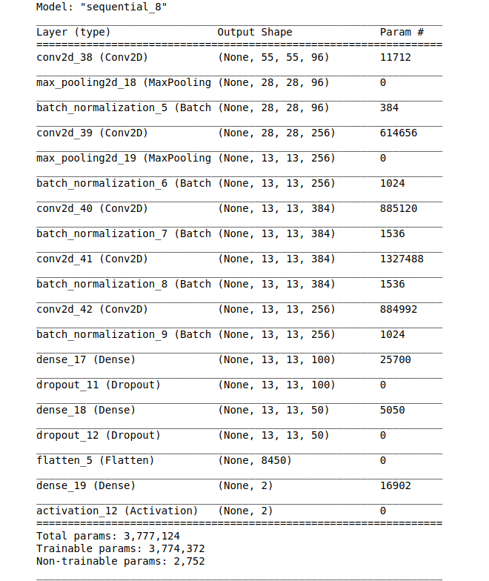
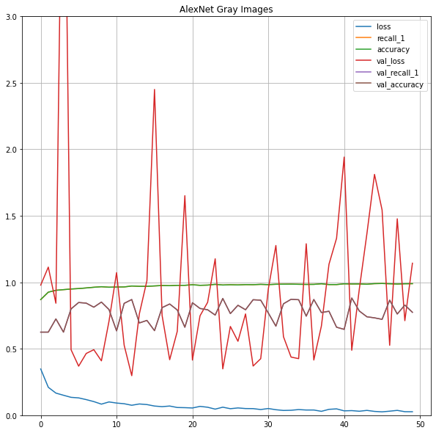
Building the Models: AlexNet (reduced params)

Slide 7
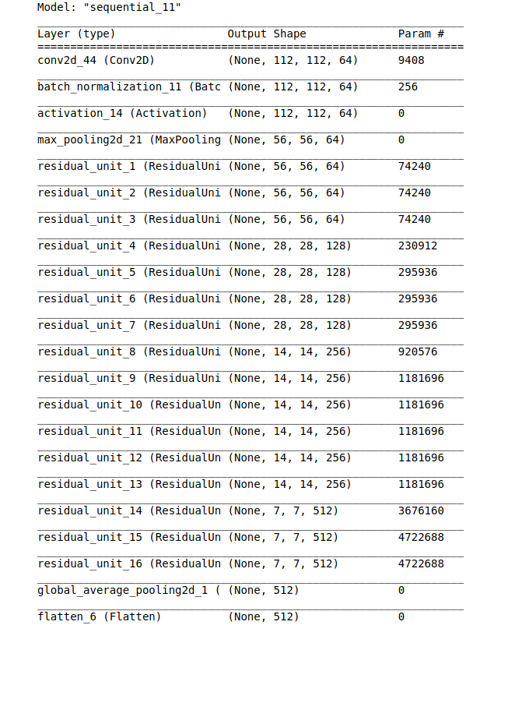
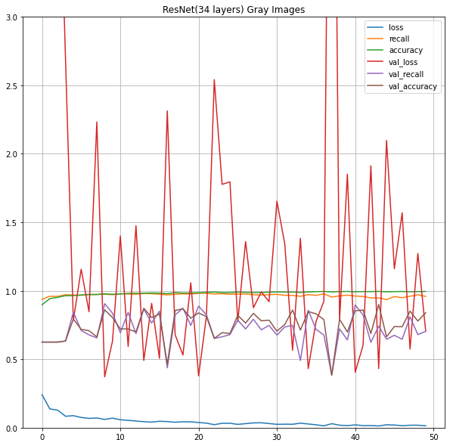
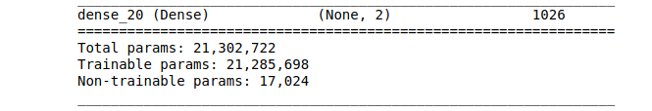
Building the Models: ResNet (34 layers)

Slide 8
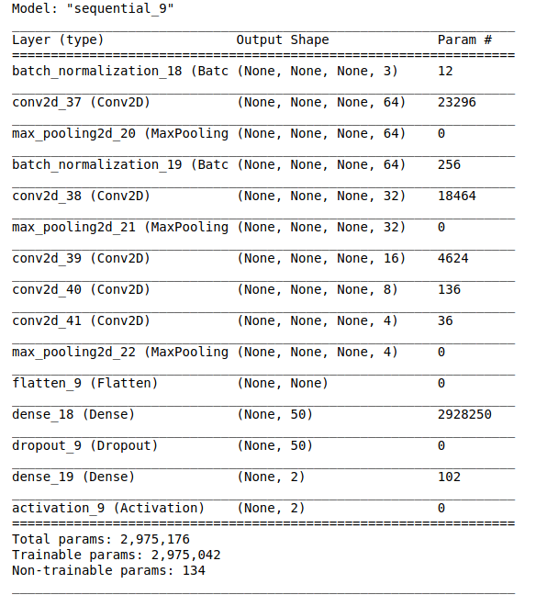
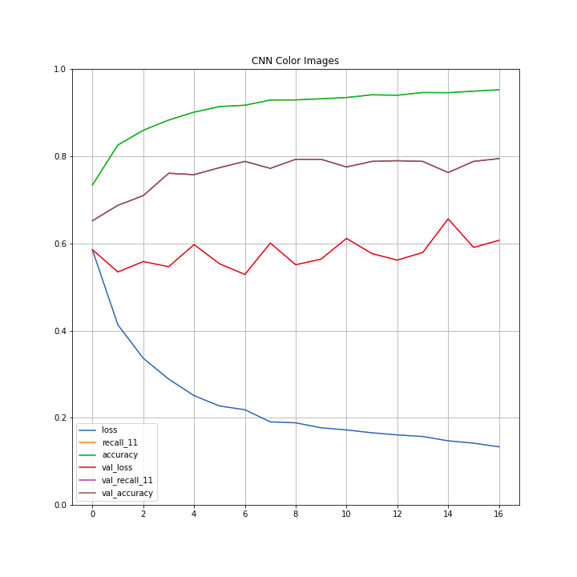
Building the Models: MNIST CNN Color

Slide 9
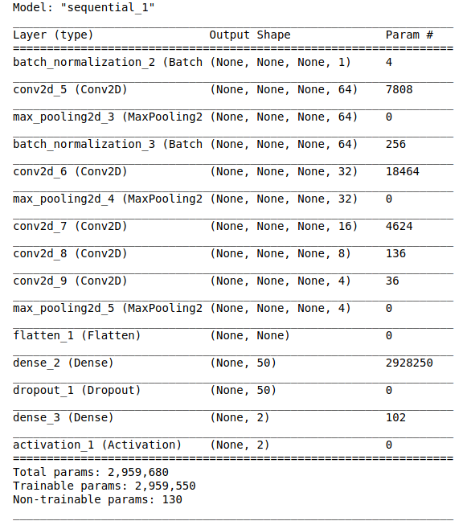
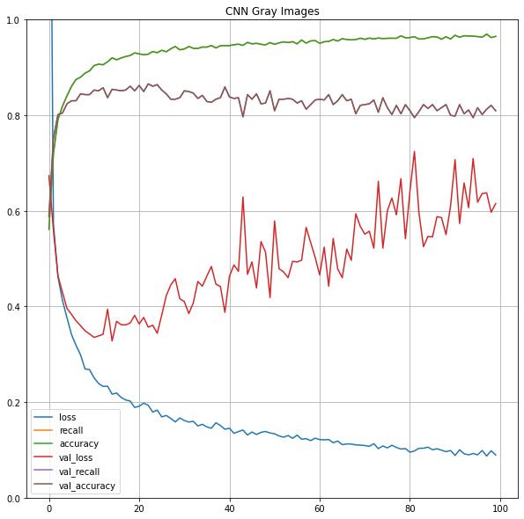
Building the Models: MNIST CNN Grayscale

Slide 10
Hyperparameters and other features that seem important to this dataset:
Learning Rate: Tuning this far lower than I initially thought produced better results across all models.
BatchNormalization layers: Adding these helped my models train longer without overfitting.
Kernel Size: If I start with larger kernel sizes and work my way down, I generally saw better results.
Dropout: Helpful, but don’t put too many layers of this or else you give your network brain damage.
Trainable Parameters: Land meant what he said by keeping it under ~4 million trainable parameters. Any of my models over this just couldn’t get anywhere.

Slide 11
And the winner is...

Slide 12
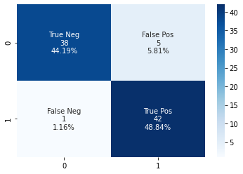
The MNIST CNN Grayscale! (modified)
Precision: 89.4%
Recall: 97.7%
F_Score: 93.3%
Accuracy: 93.0%

Slide 13
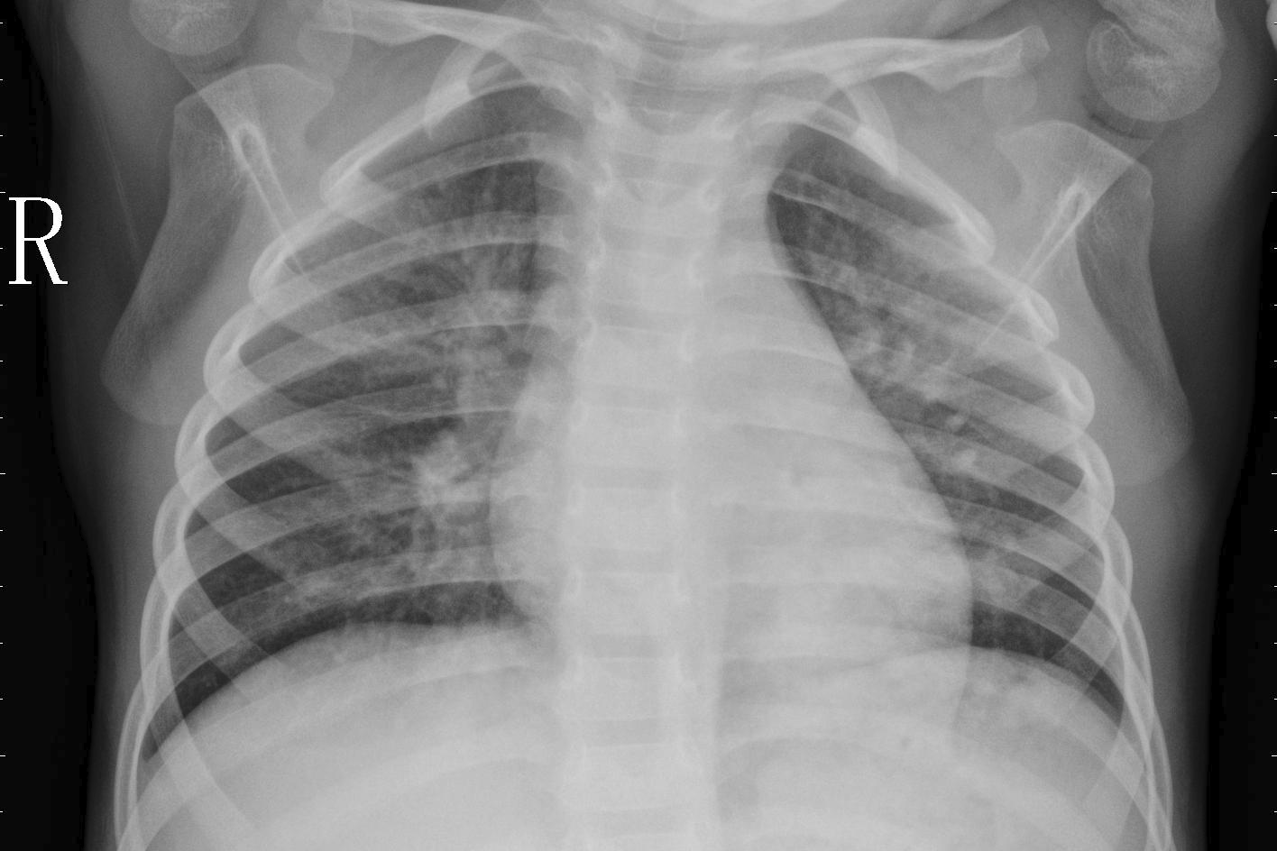
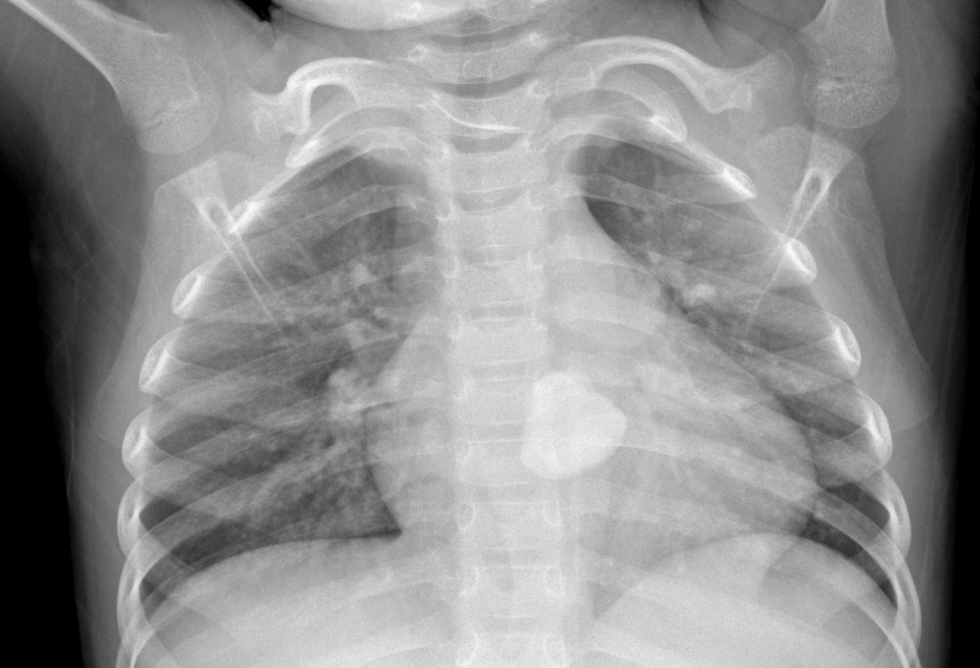
I can’t tell either...

